Slide 1
In silico data analysis With Weka
A simple introduction of weka

Slide 2
Weka Explorer

Slide 3
Intro
Weka explorer is a comprehensive Graphical User Interface for weka API. It allows you to train, test, filter and visualize your data. Multiple algorithms and functions are available for express use with plenty of flexible options. Since most of us will deal with more classification problems, I’ll just take classification as an example. More Specifically, I’ll demonstrate how I simulate the work in “In silico DMD” paper.

Slide 4
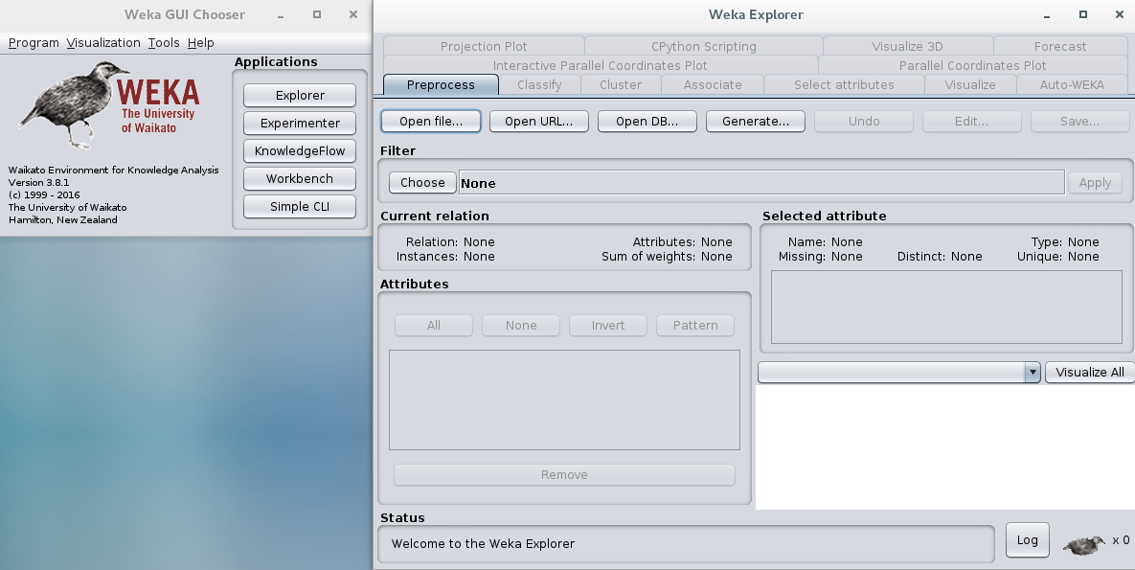
Preproccesing
Filtering out unnatural data is necessary at most of the time, because your evaluation metrics such as R^2 can vary from each point. Weka provide you general filters, supervised learning filters and unsupervised learning filters. They also provide you freedom to write a filter script in python.

Slide 5
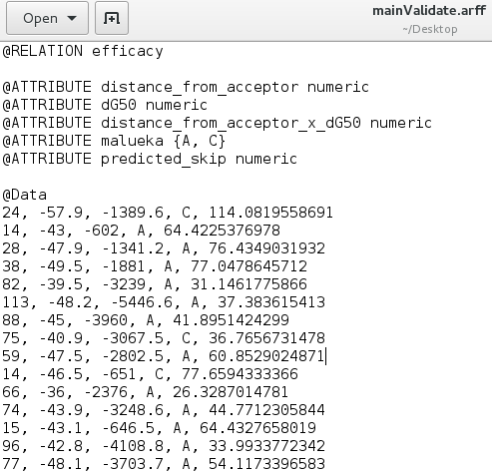
Data file Why *.arff?
Weka gives you the option to use *.csv spredsheet as your data file, then why am I still recommending to use *.arff? Because *.arff can clearly separate attributes definition and plain data and can give you the chance to define the data type for each attribute, then which column is numeric and which column is nominal or binary is simply known on parsing phase. On the left is a snapshot of in silico data.

Slide 6
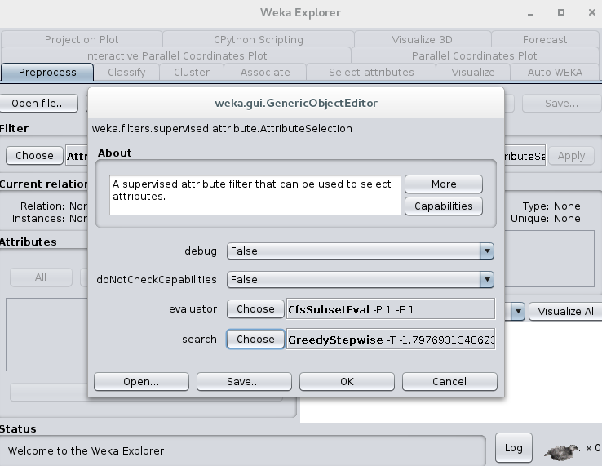
Filter Selection
For this example, I’ll demonstrate one method of attribute selection. Statistics-wise speaking, AIC or BIC can be used to evaluate the significance of a variable in stepwise regression. We use them to prune variables that are less significance. In weka, it’s simple. You click filter button and then you can choose which filter you want to use. Since “in silico DMD” paper uses stepwise regression, we can choose greedy stepwise as our search algorithm.

Slide 7
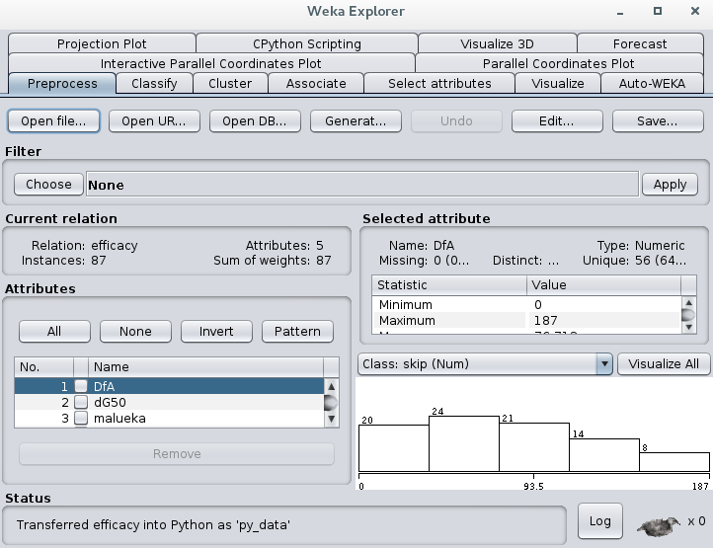
Train and Test I
We have more than two variables to correlate, so I’ll demonstrate how to implement multi-variable linear regression in weka. First, you choose your data file and apply filter to your data, be sure your data does not have invalid types or values. Weka will display the general metrics of your data, such as mim, max, mean, std_deviation etc after preprocessing your data.

Slide 8
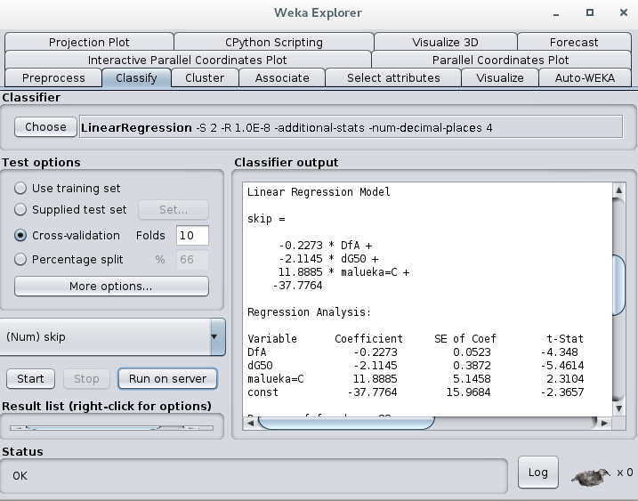
Train and Test II
Then switch to “classify” tab, choose the LinearRegression in function folder as your classifier. By clicking the frame which contains the command line, you can choose your self-defined options, such as display R^2 value, f-stat, etc. For instance, You can define if you want to use M5 search method or greedy method.

Slide 9
Train and Test III
In test options panel, weka allows you to choose a test set *.arff file as your test data. It also allows you to do cross validation on your entire data set.

Slide 10
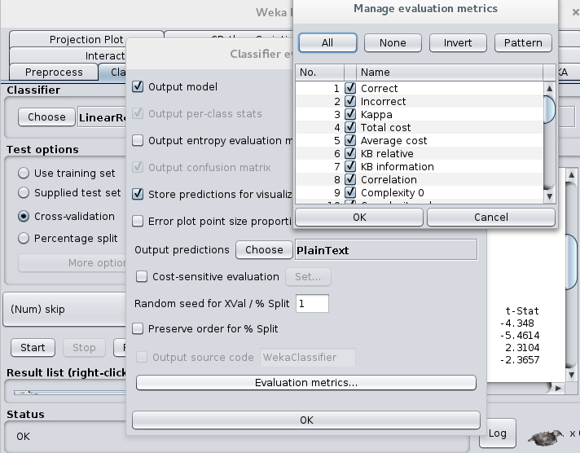
Train and Test IV
By clicking “More options” in Test options panel, you can choose whether you want to display output preditions. You can also prune unnecessary evaluation metrics.

Slide 11
Train and Test V
Once you’ve done the above steps, simply hit start and weka will display all model info in the main console.

Slide 12
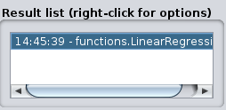
Train and Test VI
In this panel, you can right click for options like test your trained model on testing set and you can also visualize your model with data.

Slide 13
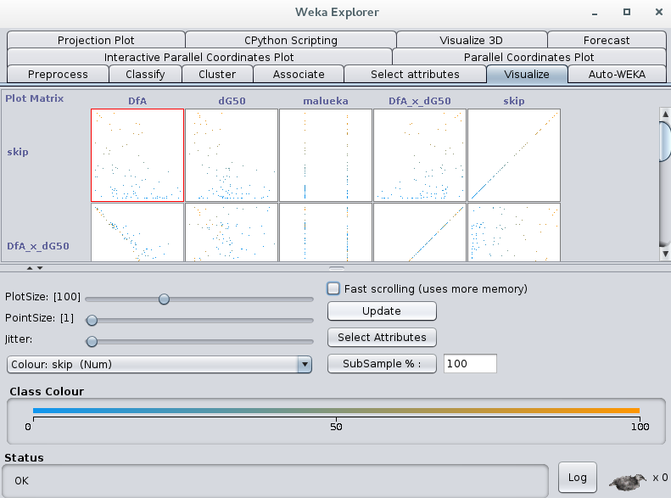
Visualization
Weka will automatically visualize all type of data after you input your data. For high dimensional data, weka gives you the opportunities to either visualize it in 3D or classify them in different color if we have nominal variables. I use this visualization to validate the trained model manually.

Slide 14
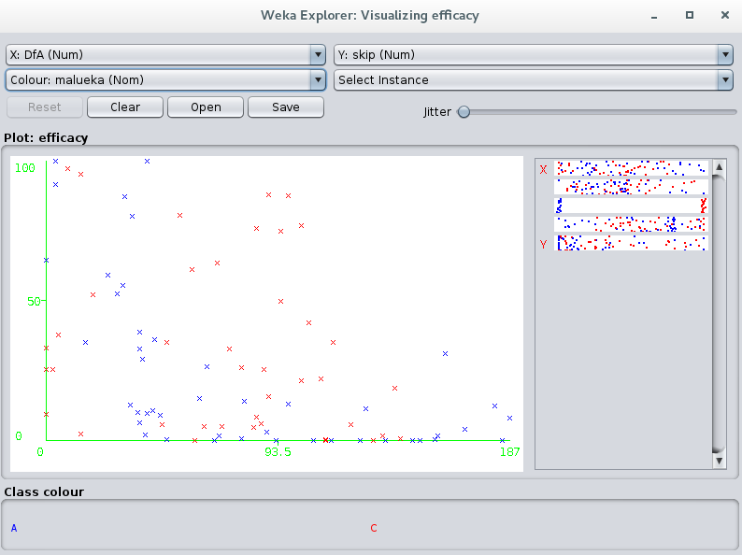
Visualization
Weka will automatically visualize all type of data after you input your data. For high dimensional data, weka gives you the opportunities to either visualize it in 3D or classify them in different color if we have nominal variables.

Slide 15
Programming Effort

Slide 16
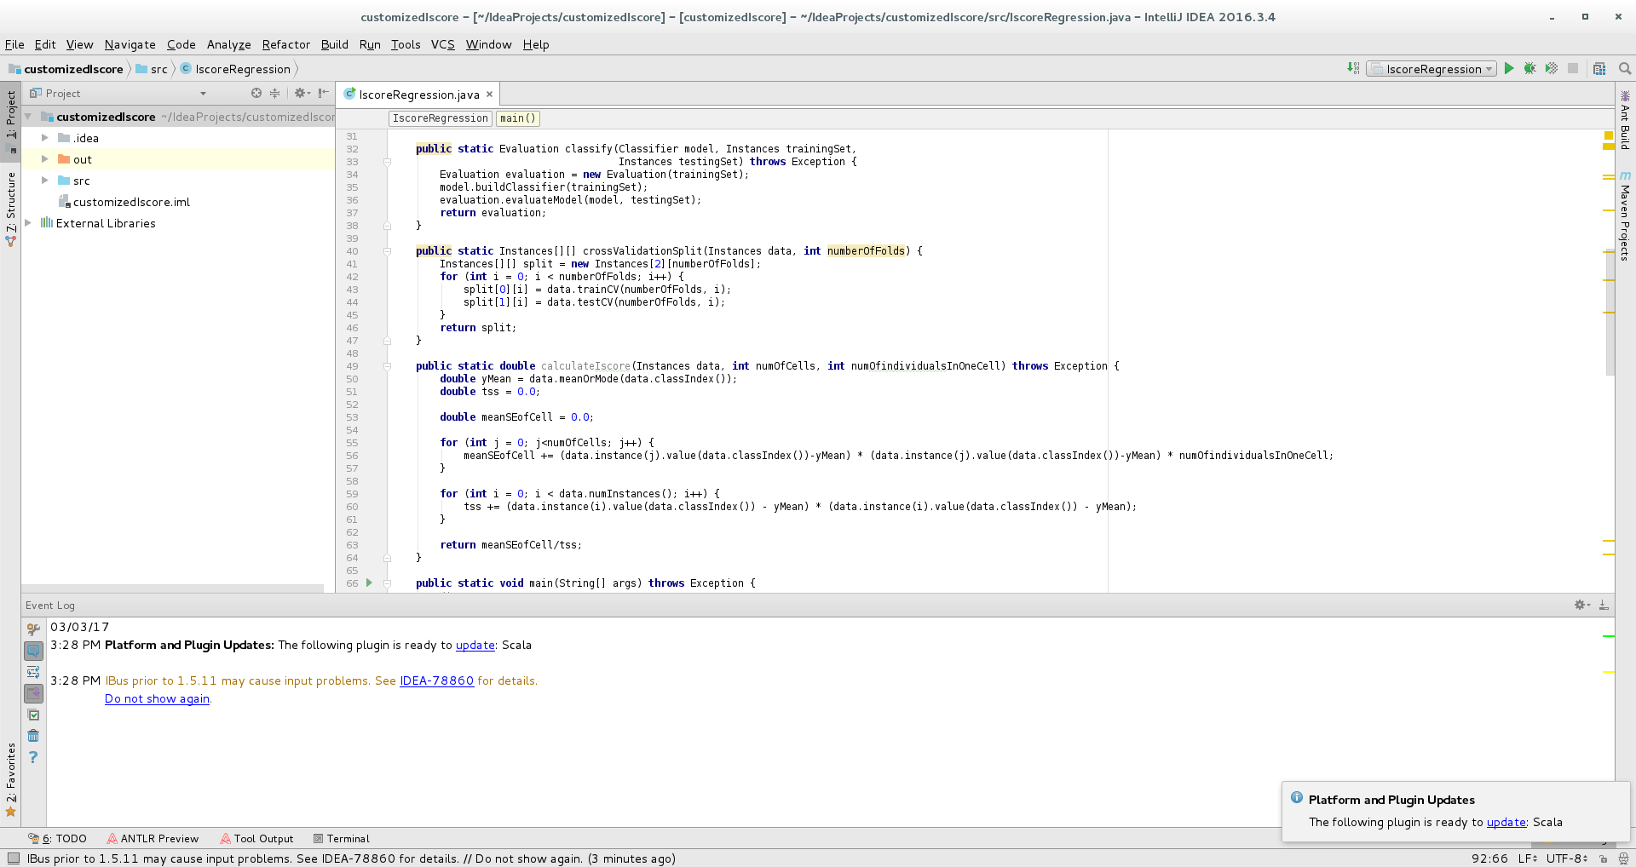
Using the API
For people who have programming experience, you can make change/add class to weka API which allows you to have more flexibilities to apply your own algorithms or evaluation metrics.

Slide 17
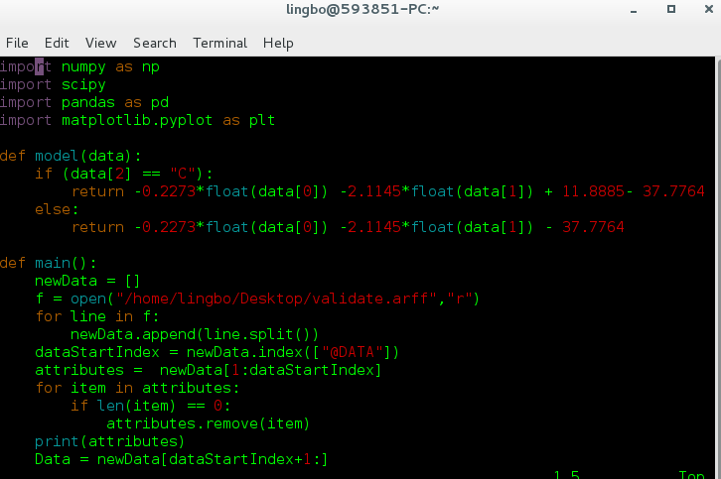
Scripting in Python
Weka has done a huge amount of job to reduce the programming effort, however, it brings limitation at the same time. Some classes are over encapsulated (getters and setters are protected in some classes). For more flexibility, you might want to use python when you want to preprocess (filter) or postprocess (plot) your data.

Slide 18
External Recourses
If you downloaded weka, it comes with a manual
Weka API: https://github.com/bnjmn/weka
Data Mining with Weka Mooc: https://www.youtube.com/user/WekaMOOC

Slide 19

Thanks!
Contact me:
Lingbo Tang
lingbo@ualberta.ca

